Slide 1
ISO-PIPE: Isolated Pipeline Execution within a Microservice
A Patent-Proposed Runtime Resilience Design Pattern
Presented by: Browns Megam. N
Patent Submission – July 2025

Slide 2
Problem Statement
Traditional microservices share resources for read and write operations
Even 1% network or DB failure in write path can block the entire microservice
Read and write operations become mutually dependent
Users face total service unavailability, even when only writes are affected

Slide 3
Core Concept of ISO-PIPE
A runtime design pattern that isolates READ and WRITE pipelines
Ensures read operations stay functional even if writes fail
All within a single deployable microservice
Lightweight, scalable, and cloud-native friendly

Slide 4
Handling Network Failures
Network issues are often partial, not complete outages
ISO-PIPE continues to serve: cached data, read-replica DBs, last-known-good responses
Only write pipeline degrades
Separate health checks allow observability and prevent total failure

Slide 5
Business & Operational Problems Solved
SLA Violation – Read path remains online
Revenue Loss – Queue/retry writes
Escalations – Graceful degradation
Service Crash – Runtime isolation of flows

Slide 6
Technical Problems Solved
Shared thread pools → Isolated Executors
Global circuit breaker → Separate CBs for Read/Write
DB unavailability → Cache-aside fallback
Single health status → Dual health endpoints
Need for multiple microservices → One service with two pipelines

Slide 7
Existing Solutions vs ISO-PIPE
CQRS / Dual Services – Infra heavy → Single deployable unit
Manual Fallback – Inconsistent → Built-in and centralized
Single Circuit Breaker – Total failure → Partial degradation possible
Unified Health Check – No visibility → Granular health endpoints

Slide 8
Futuristic Nature
Built for Kubernetes, Docker, event-driven systems
Suitable for telecom, banking, e-commerce
Compatible with Kafka, Redis, RDS, Prometheus + Grafana
ML-based traffic shaping, predictive rerouting

Slide 9
Future Enhancements
ISO-PIPE SDK for Spring Boot / Java
Tenant-aware pipeline isolation
Kubernetes autoscaling of read/write independently
Kafka buffering and delayed writes
SLA scoring dashboards for read/write metrics

Slide 10
Summary
ISO-PIPE is a novel, production-grade runtime isolation pattern
Ensures read-heavy operations remain functional during write-side failure
Eliminates service-wide outages
Simplifies architecture and reduces operational cost

Slide 11
Network Failure Handling – Clarification
Handles partial failures gracefully with isolation and fallback
Read pipeline continues to work using cache or stale data
Full network failure affects all systems – not unique to ISO-PIPE
ISO-PIPE reduces impact radius and preserves functionality

Slide 12
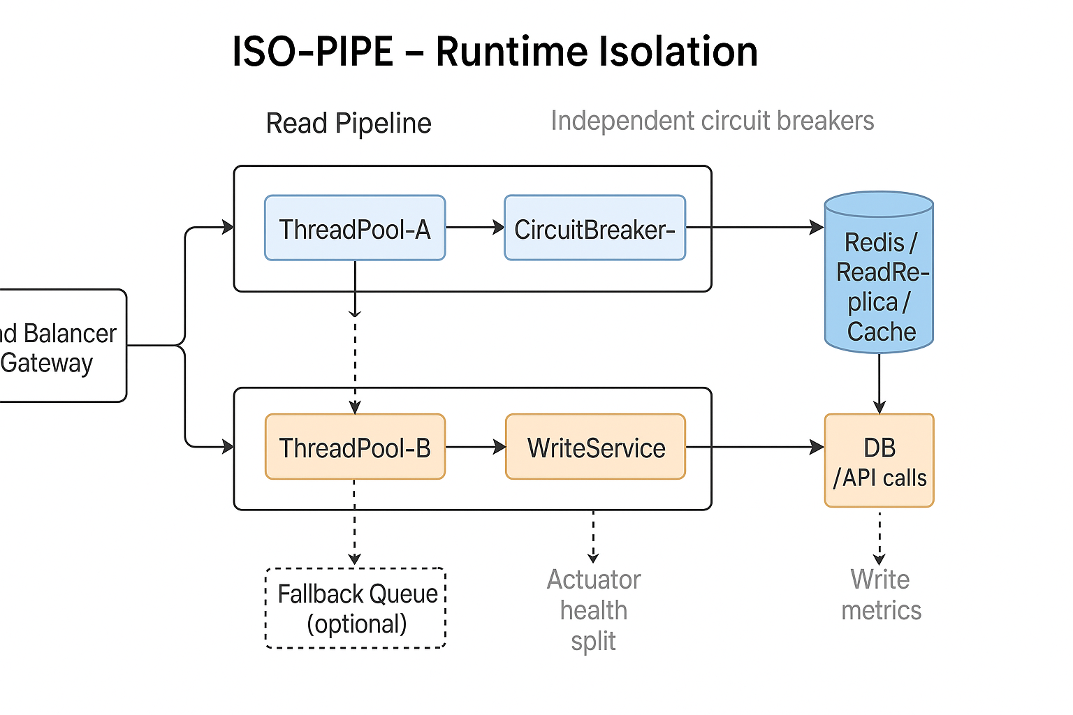

Slide 13
THANK YOU!
Browns Megam. N
Phone
9535492339
Email
Bigfish.browns@gmail.com

